Slide 1

Google Charts
Courtney Zimmer
IST-719

Slide 2
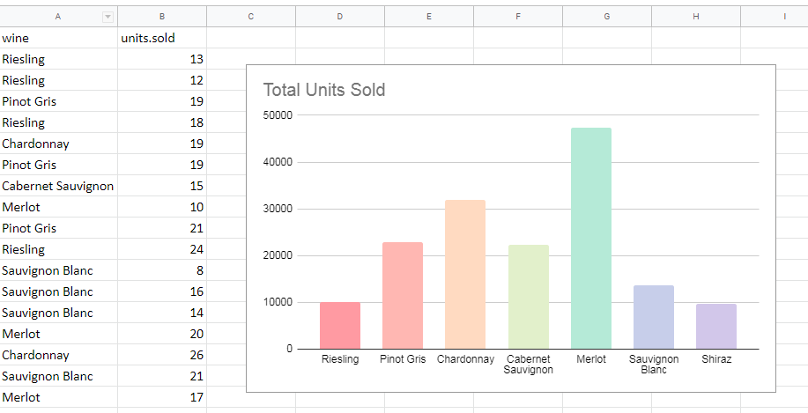
Google Chart is Not

Slide 3
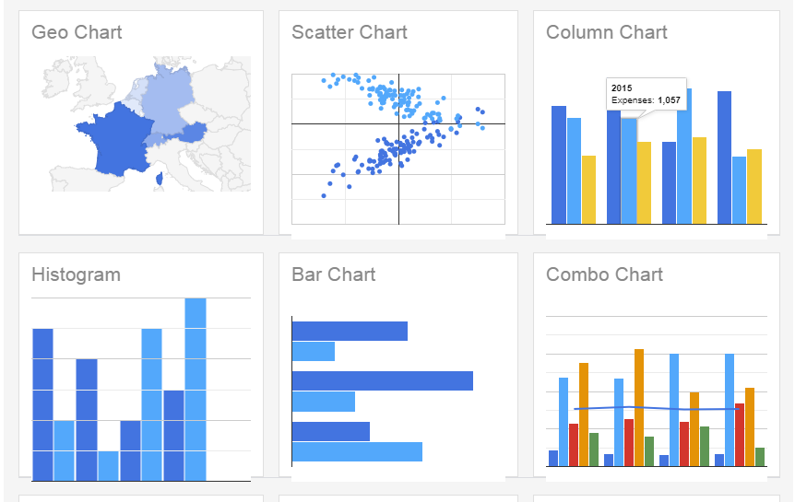
What is Google Charts?
JavaScript embed in your web page
Open source chart library & fully customizable
Dynamic graphs
Dashboards
Data embedded or pulled from a spreadsheet
Notes:
Google charts is an open source chart library that allows you to create and customize dynamic chart that can be embedded in your web page using JavaScript.

Slide 4
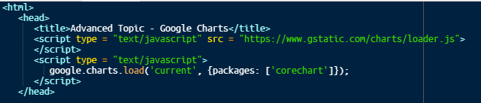
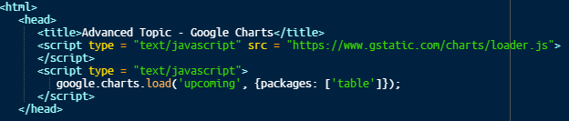
How does it work?
Google Chart loader
Goes in the <head> of your webpage
Loads Google Chart release
Type of chart package
Corechart
Table
Sankey
Notes:
The releases will be identical except for when a new release is on its way. It’s good to use this if you want to test a new chart or feature that is about to be released.

Slide 5
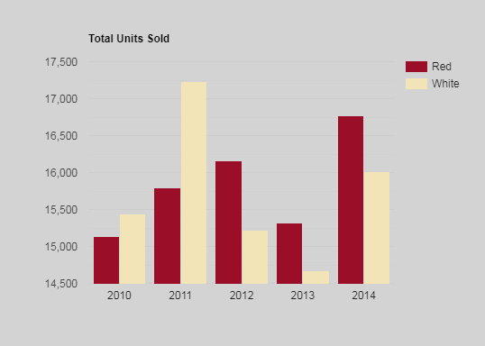
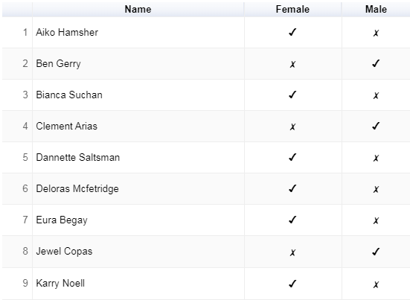
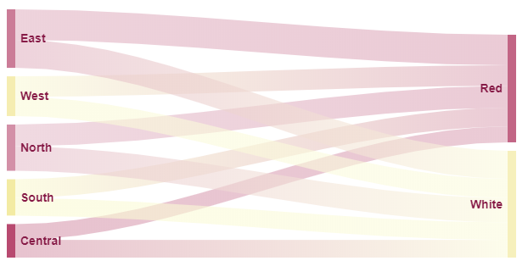
Google Chart Packages
Corechart
Table
Sankey

Slide 6
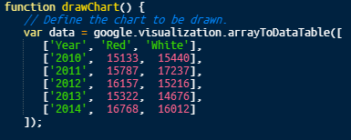
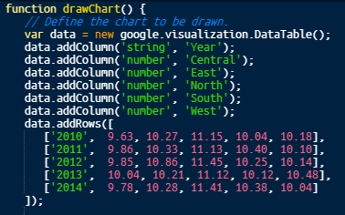
Loading in the Data
Data Sources
DataTables
Connect to Database
Connect to Google Sheets

Slide 7
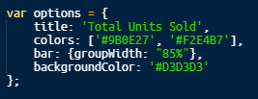
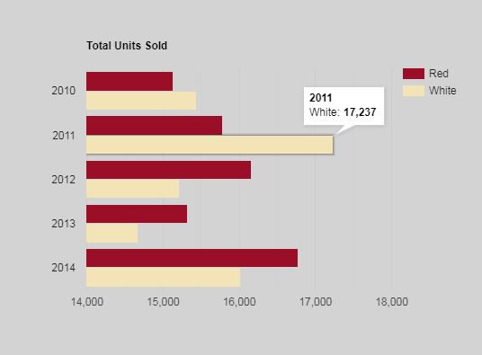
Customizing your graph
Specify options
Legend
Title
Subtitle
Colors
Background
3D
Bar graph (grouped, stacked, etc.)

Slide 8

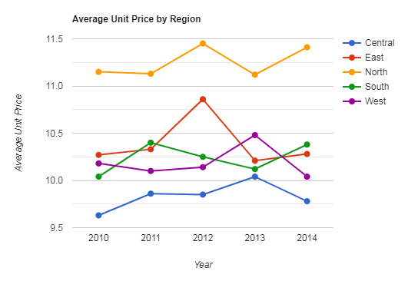
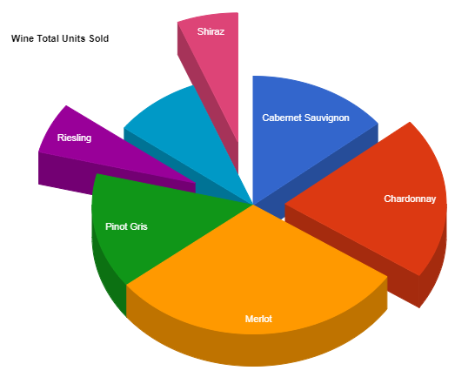
Draw the Chart

Slide 9
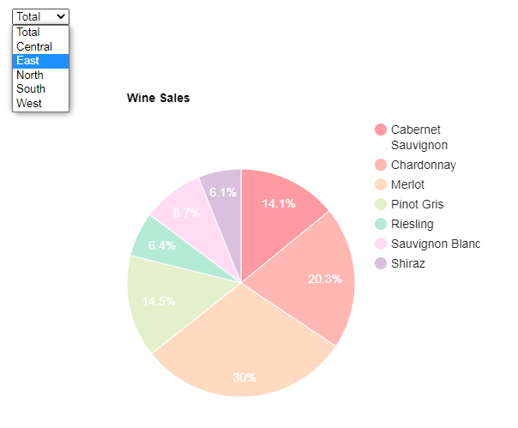
Dashboard, Controls and so much more

Slide 10

Courtney Zimmer IST-719

